Slide 1
CT Project Weekly Status Report
By Jack Xu

Slide 2
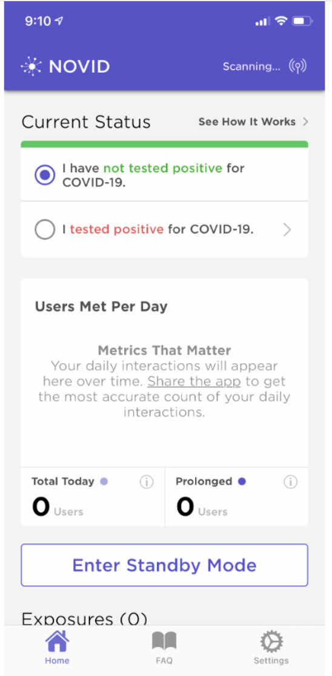
Plan for this week
Find and analyze existing solutions and applications
Define general features of our CT application
Learn the capability of HMS kits to see:
What we can use
How we are going to use them
Our work this week
Made a review of existing applications and produced a comparison doc.
Defined general features to produce:
Two displaying panels
Been notified when exposed to coronavirus patients

Slide 3
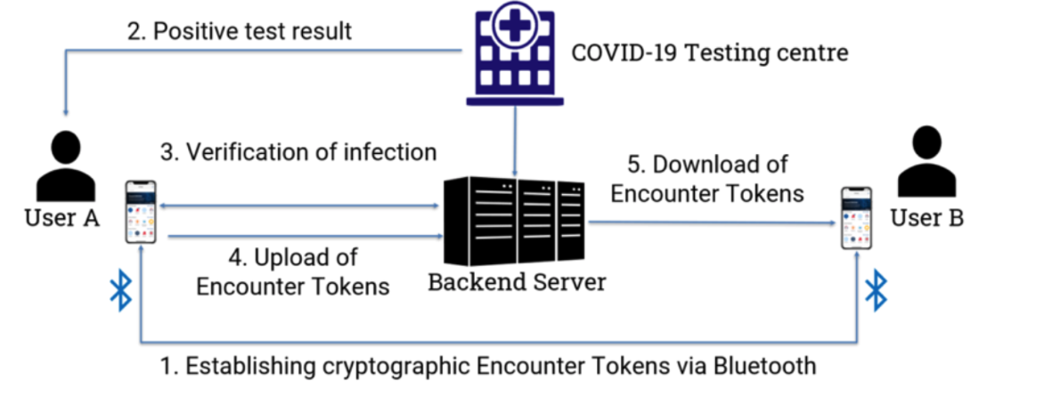
Our work this week
Made a review of existing solutions and proposed our general architecture.
Tried Nearby kit and push kit which are most likely to be used this our project.

Slide 4
Plans for next week
Finish Analysis of solutions including Google and apple
Work with Jenny to analyze UI/UX design of other solutions
Define features in a more specific way
Present the analysis of solutions and features of App

